Slide 1
DC resistivity survey design with SimPEG
Michael Mitchell

Slide 2
Gravel & Till
Brine Injection Well
Head-Frame
Sandstone
Shale
Shale (Red Bed)
Carbonate
Shaft
Evaporite
Evaporite (Potash)
Lower Dawson Bay Aquifer
Second Red Bed
1 km
Power Cable
Potash
Mine Workings
?
Pipe
Pump
200 m
Prairie Evaporite
Mine Workings
Saline Aquifer
Notes:
This schematic shows an overview of the problem.
Describe the environment, location of mine workings, and 2 potential water inflow sources.

Slide 4
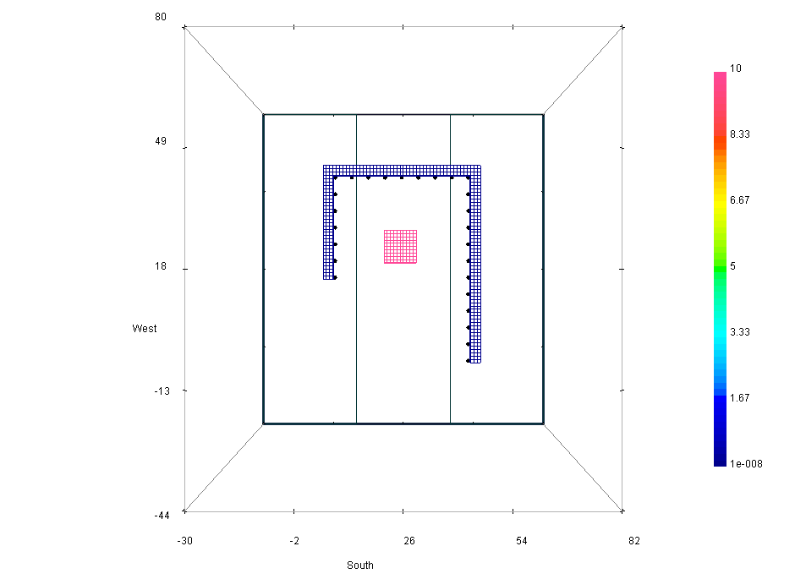
Synthetic Horse Shoe Model

Slide 5
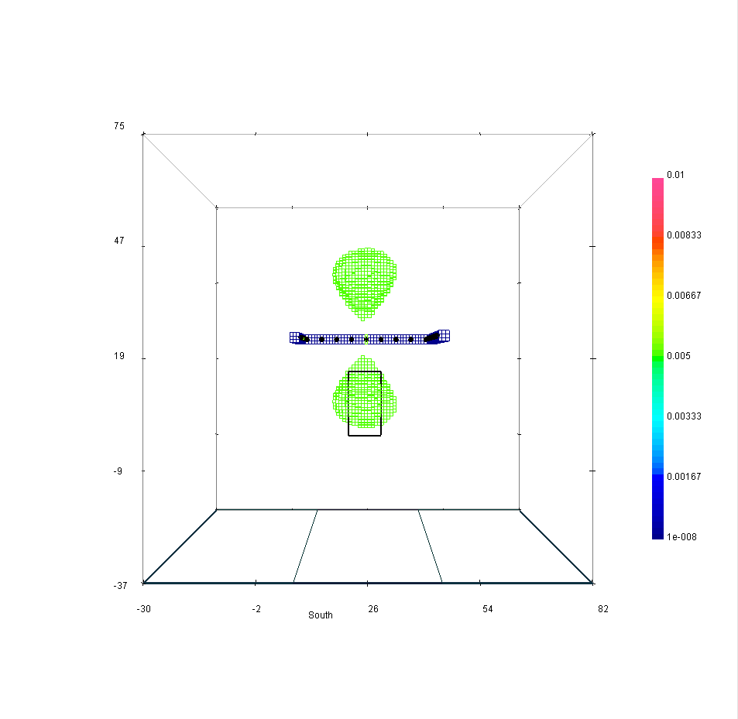
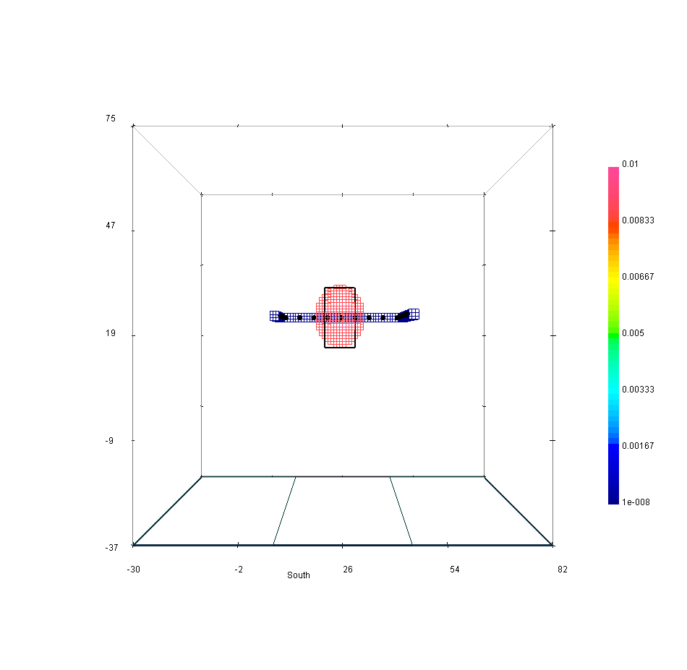
Recovered Models

Slide 6
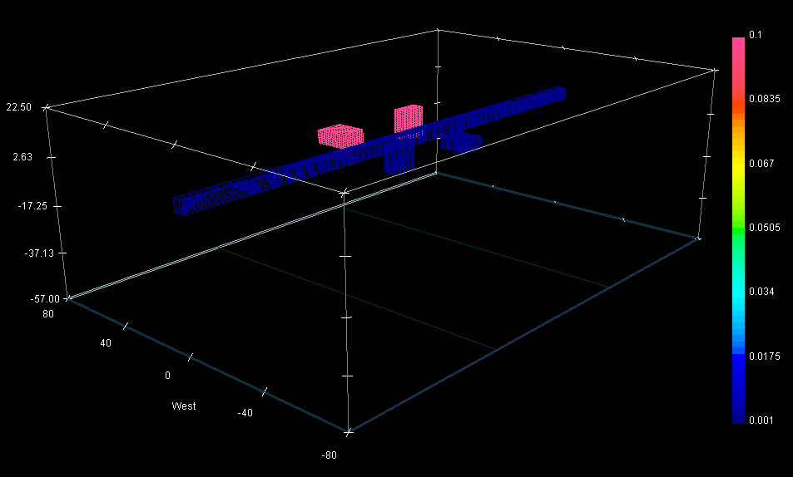
Synthetic Straight Tunnel

Slide 7
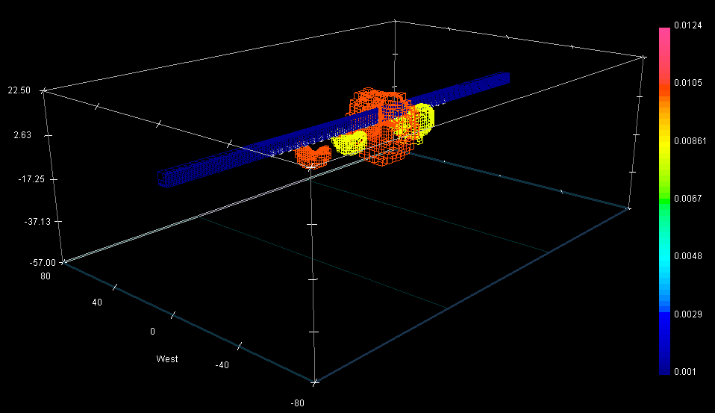
Linear Array Results

Slide 8
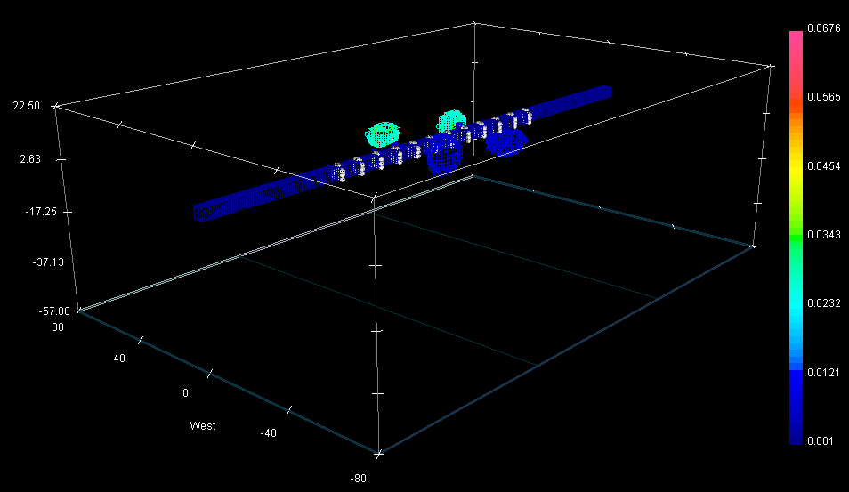
Ring Array Results

Slide 9
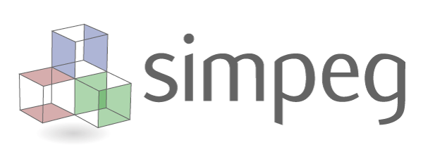
Survey Design
Ring array
Much better recovery
More costly (More Tx and Rx)
Optimal data subset?
Which Tx?
Uniform distribution of sensitivities.

Slide 10
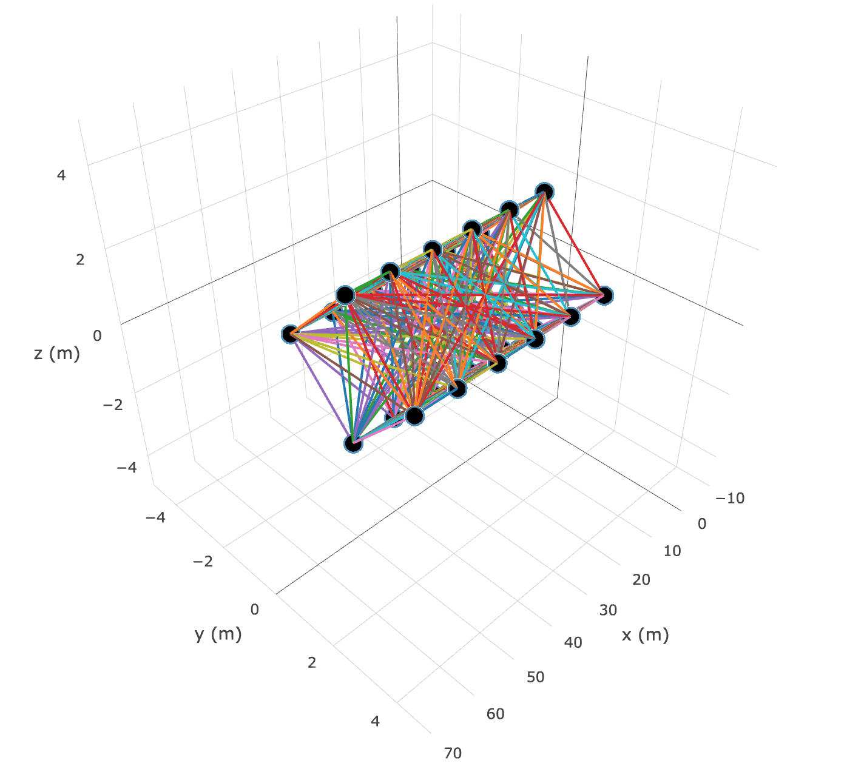
Full Survey
24 electrodes (6 rings)
All possible dipole-dipole measurements
276 Tx
63756 Rx

Slide 11
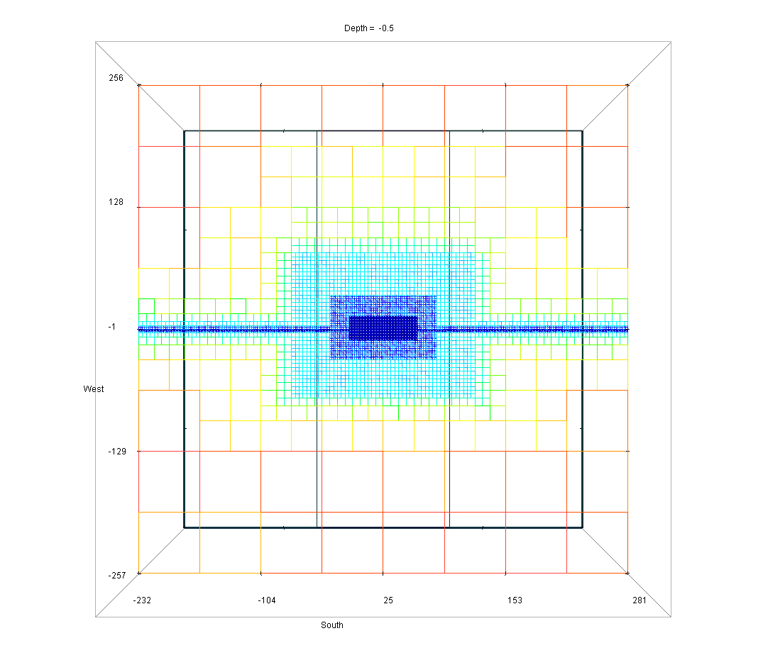
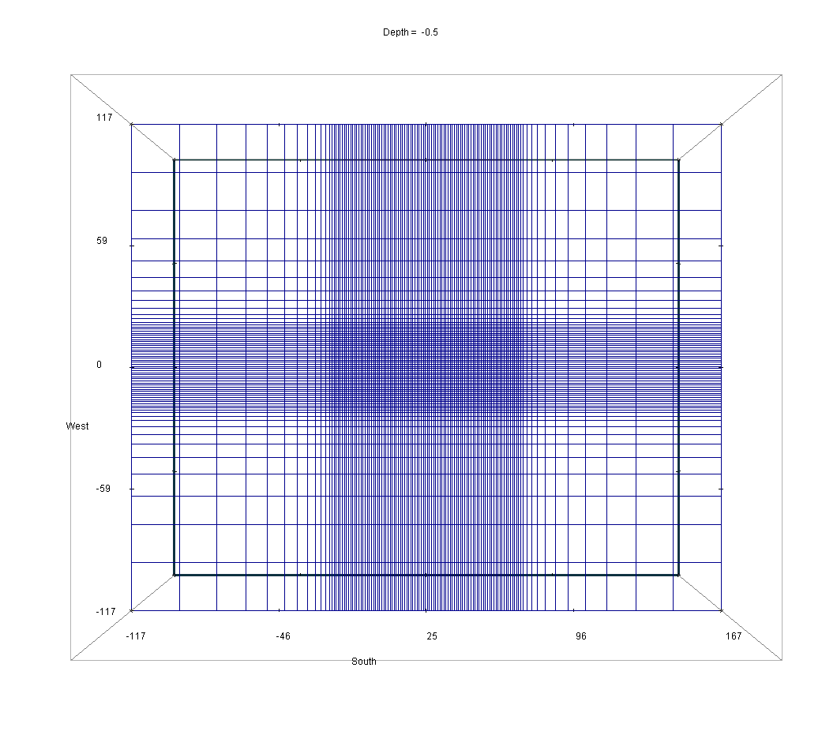
Discretization
Tensor Mesh (12 Padding Cells)
nC = 485875
Octree Mesh (200m Padding)
nC = 184710

Slide 12
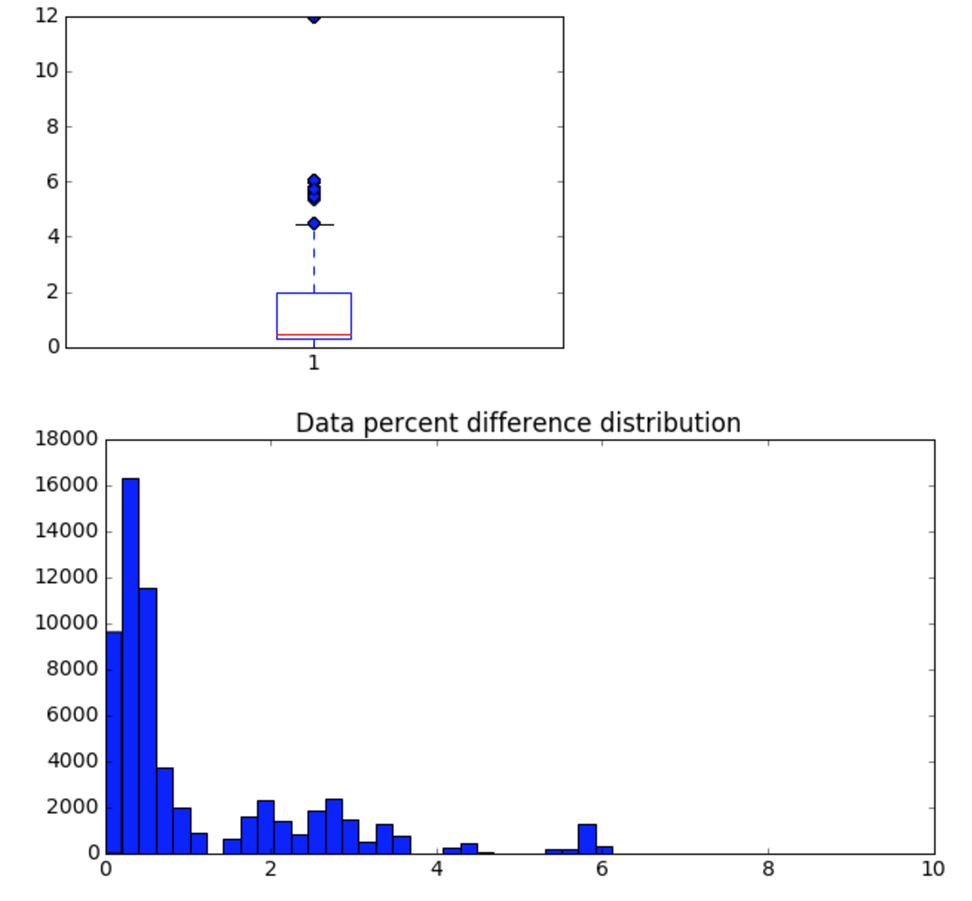
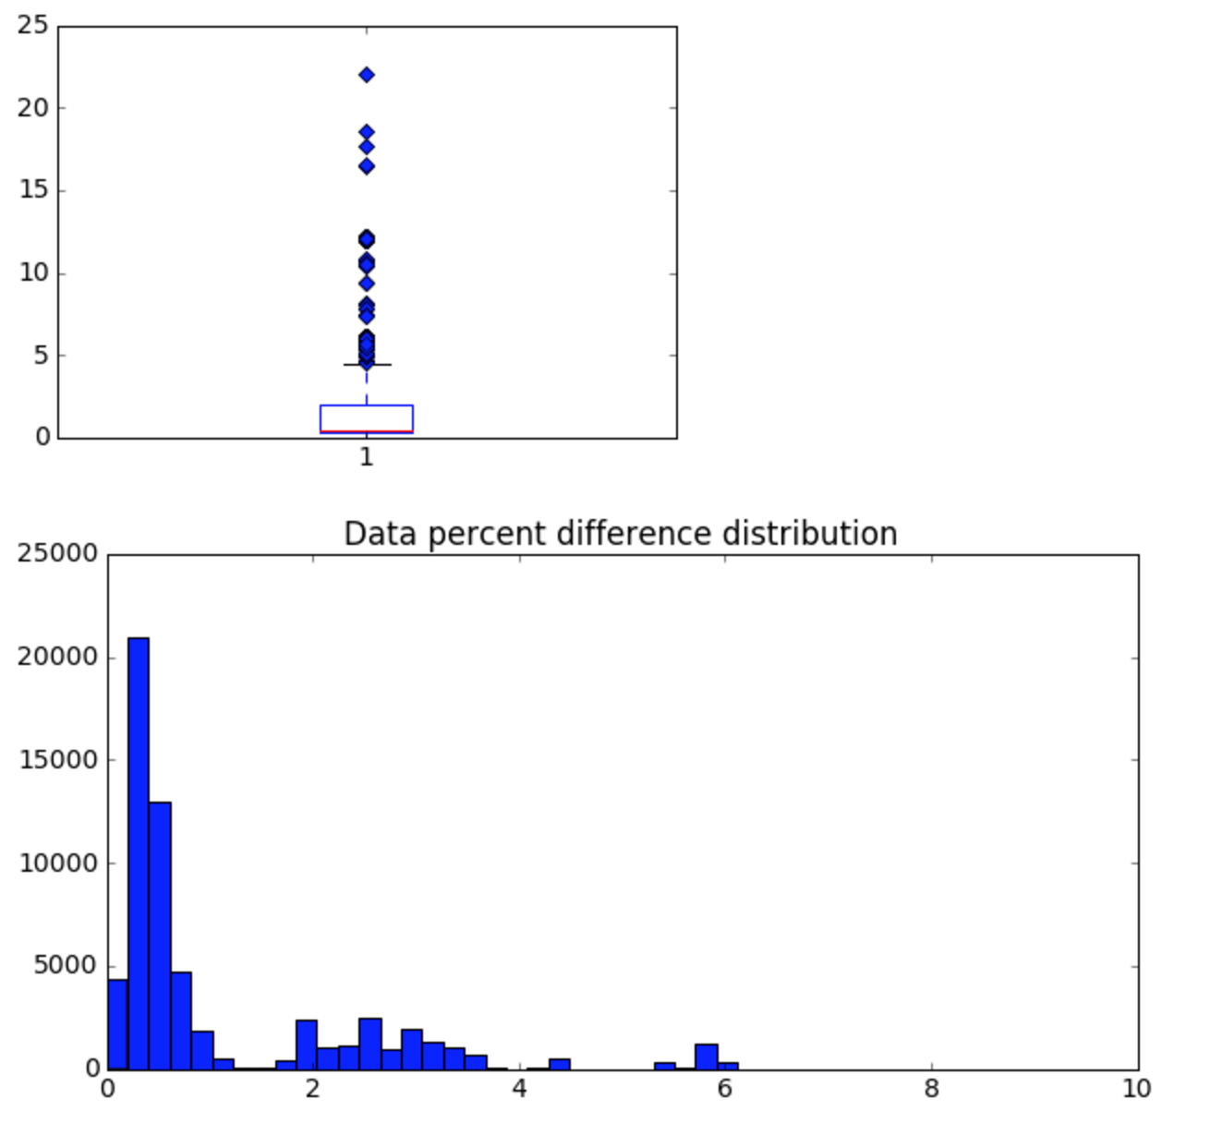
Accuracy Check (Analytic Fullspace)
Tensor Mesh:
Median % Diff: 0.474
Octree Mesh:
Median % Diff: 0.466

Slide 13
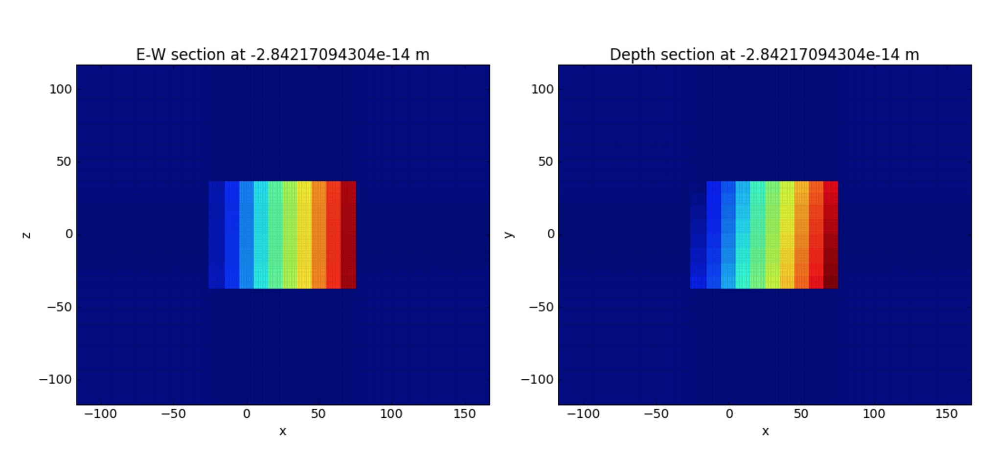
Selecting the best Tx’s
Divide ROI into blocks (i.e 10m³ Blocks-40m ROI)
Compute/Approximate diag(J^{T}J) for each Tx
Sum “sensitivities” over each block

Slide 14
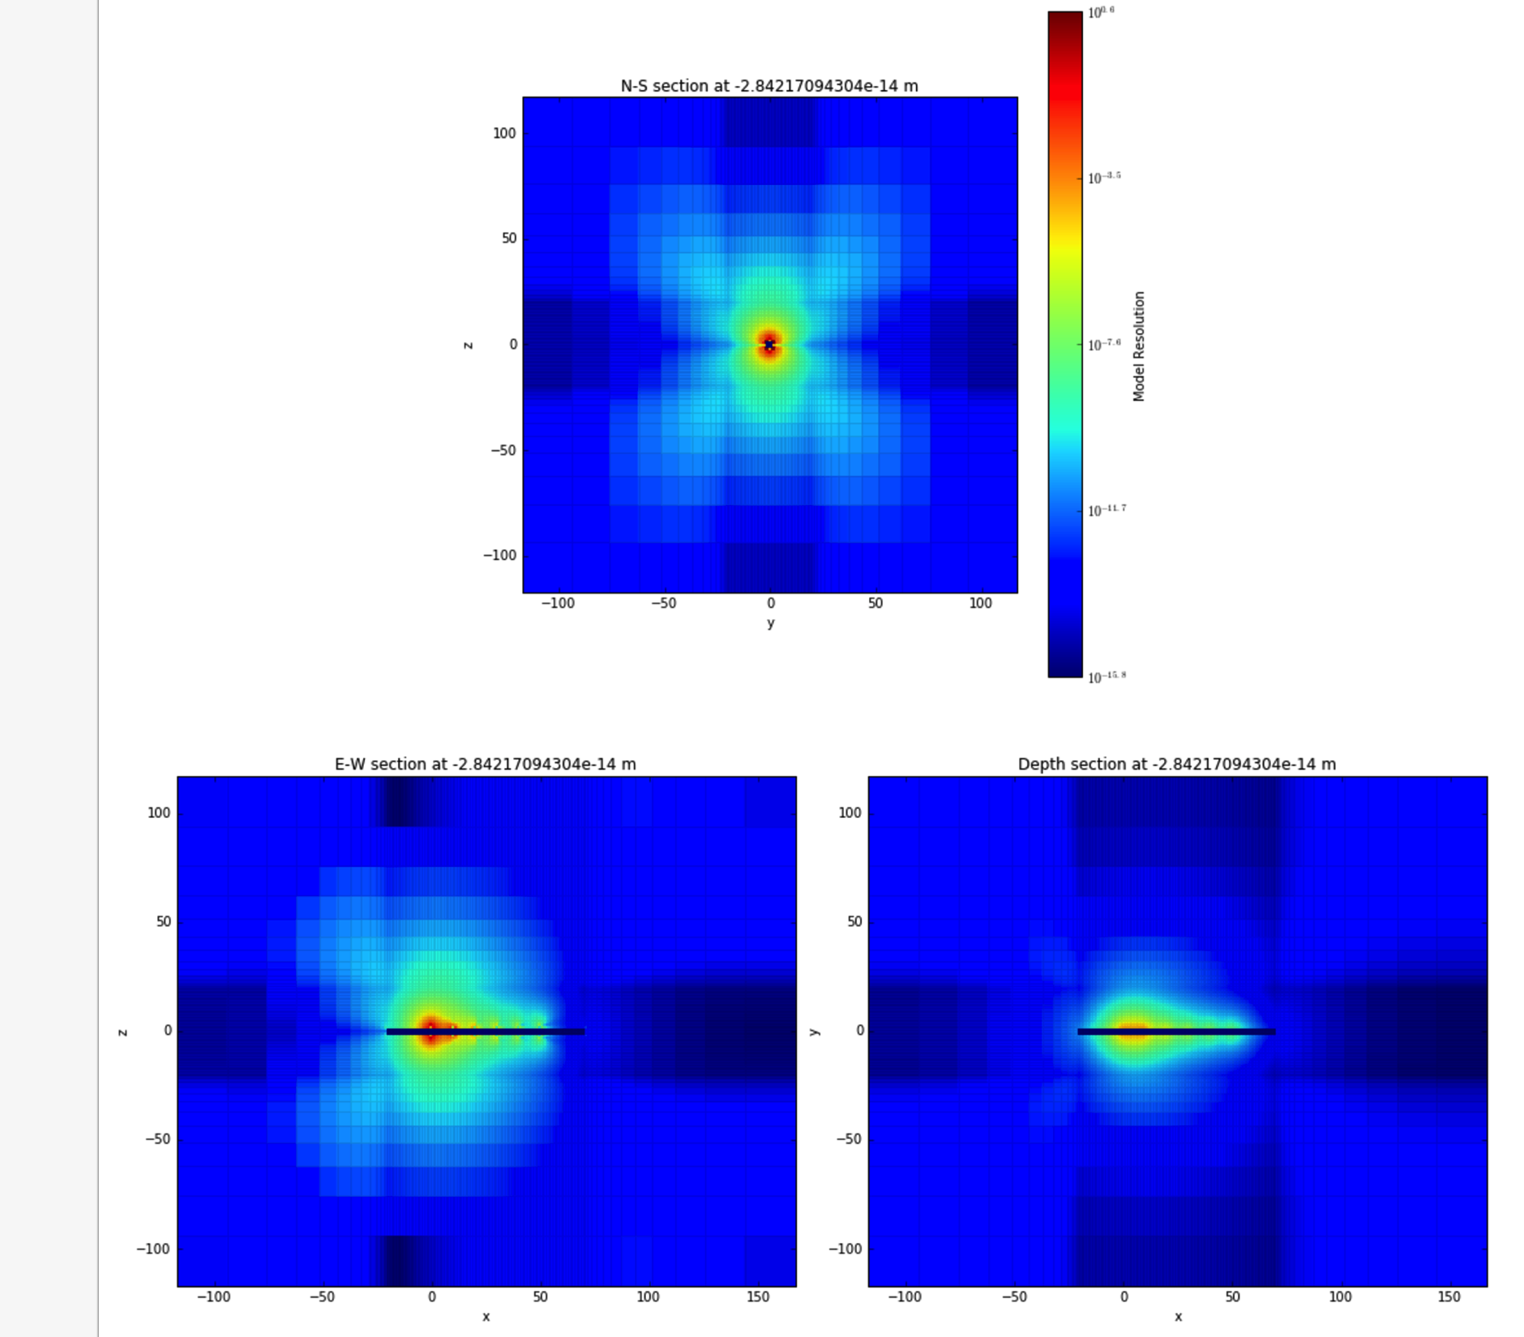
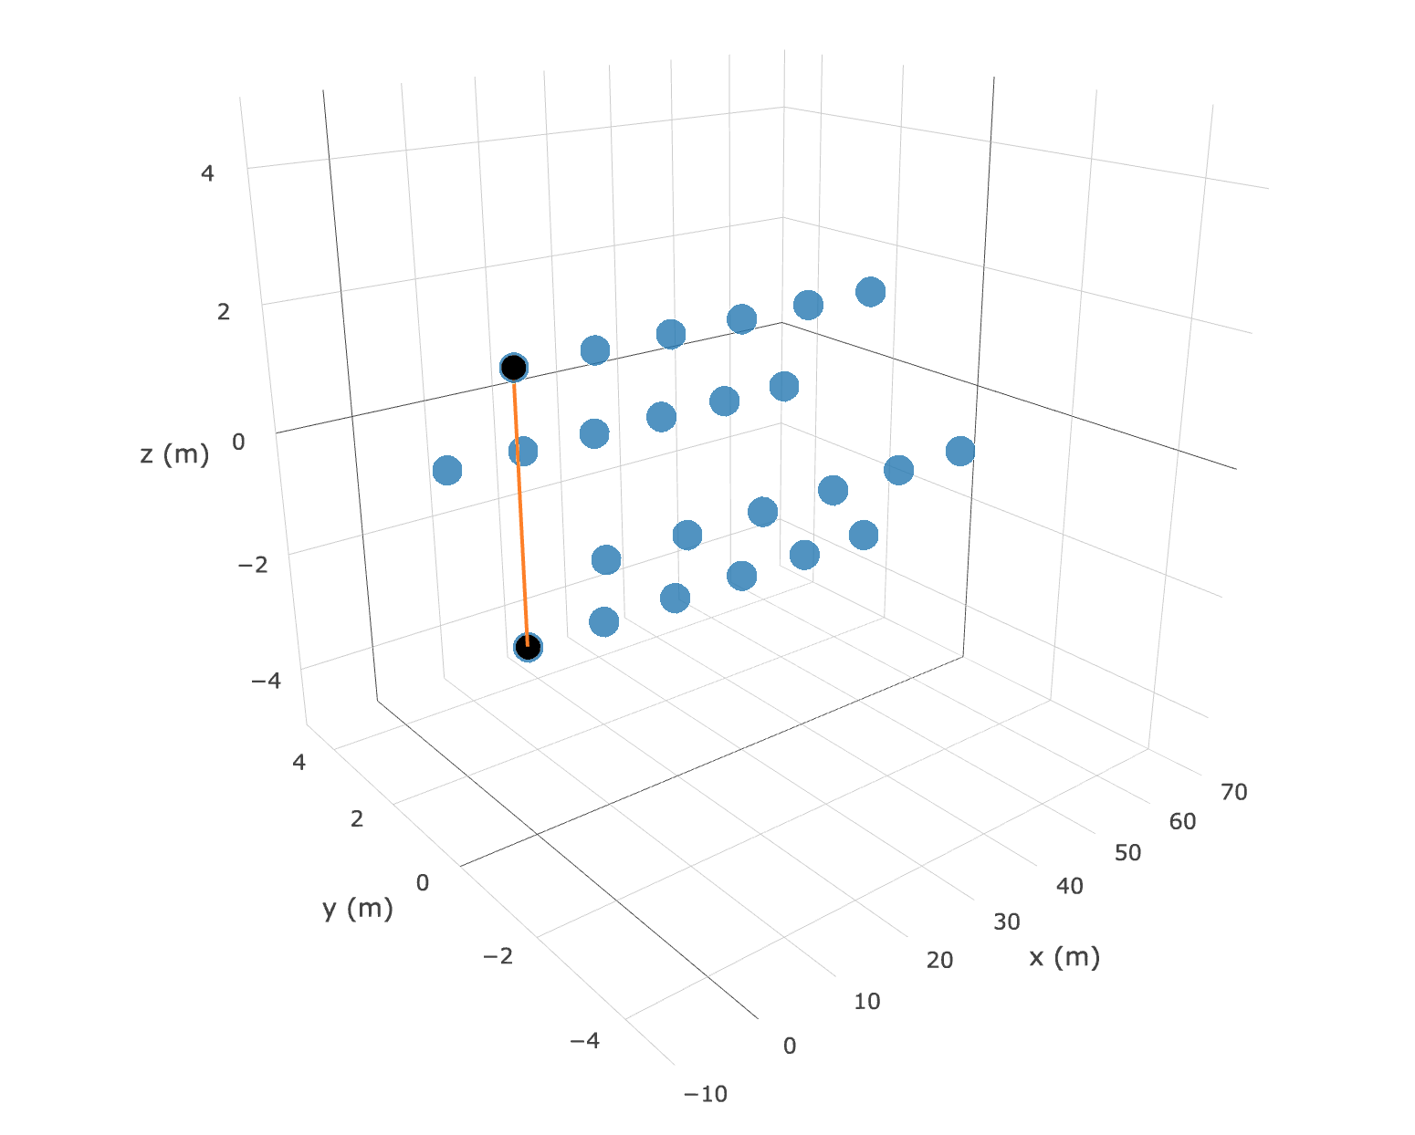
Tx #1

Slide 15
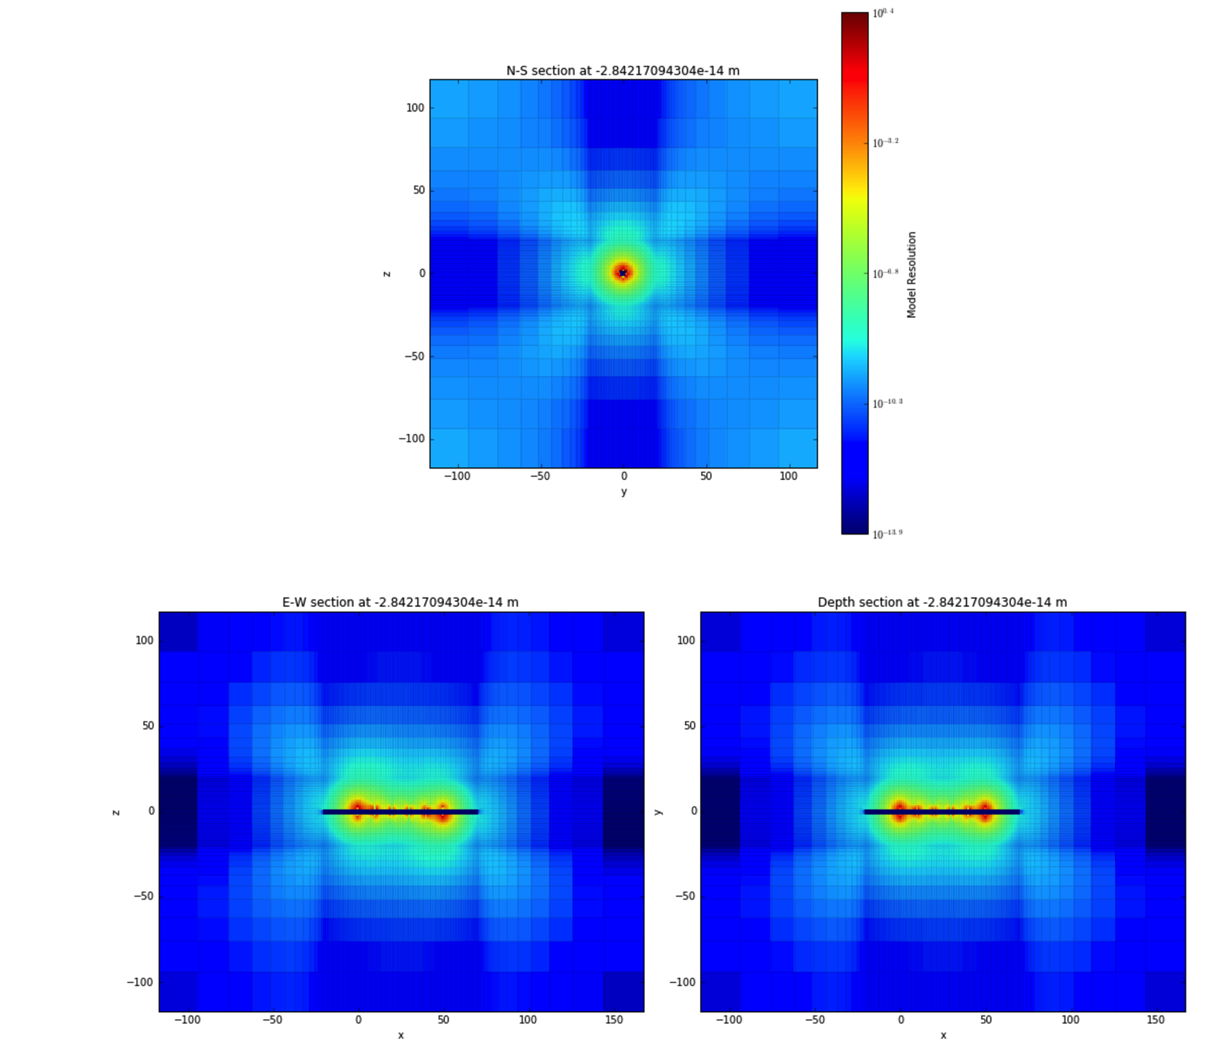
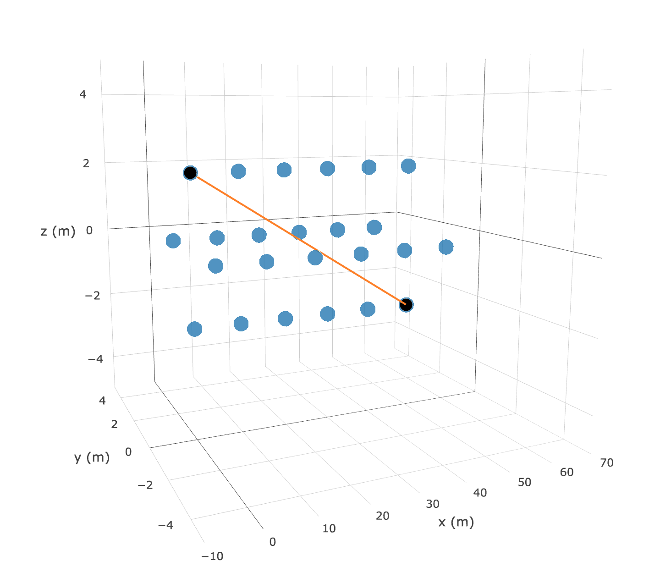
Tx # 21

Slide 16
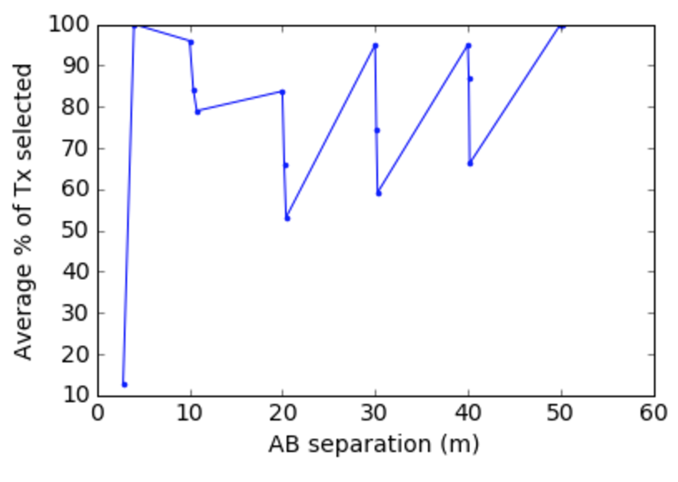
Select Tx’s with highest sensitivities for each block
Identify key AB separations

Slide 17
Selecting the best Rx’s
Detectability analysis
Largest observed change in data from randomly placed model perturbations.
equal number from each MN separation bin.
Random subset
Pseudo-random subset
equal number from each MN separation bin.

Slide 18
Inversion Validation
Invert different Tx subsets to confirm that identified subset is “optimal.”
Good model resolution with minimal # of Tx and Rx.
Regularization class
Need cellGrad stencil for octree mesh to use derivative terms in φ_{m}.

Slide 19
Generalize straight tunnel design
Characterize relationship between optimal Tx AB separation and survey parameters.
Block size
Ring separation
Tunnel length
ROI
Conductivity

Slide 20
Extend to multiple tunnels
Use straight tunnel designs along segments.
Populate region between tunnels with blocks and sum sensitivities to determine best cross-tunnel Tx’s.

Slide 21
DC Octree Discussion
Mesh and Model Building
Built base tensor model with conductivity structures.
Use UBC utilities:
create_octree_mesh.exe (Base Octree - elecLocs)
3DModel2Octree.exe (Refine Octree – σ structures)
Boundary Conditions
Homogeneous Dirchlet
Bottlenecks
Mesh.FaceDiv (~200s) vs. Fwd Problem (~8s)
mesh.getInterpolationMat very slow (using plotSlice painful)
Regularization
Need cellGrad stencil (derivative terms in φ_{m}).

